Slide 1
How React Works

Slide 2
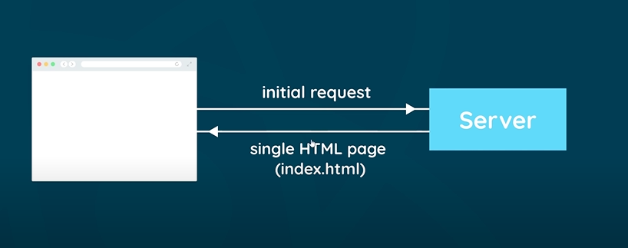
Page Rendering

Slide 3
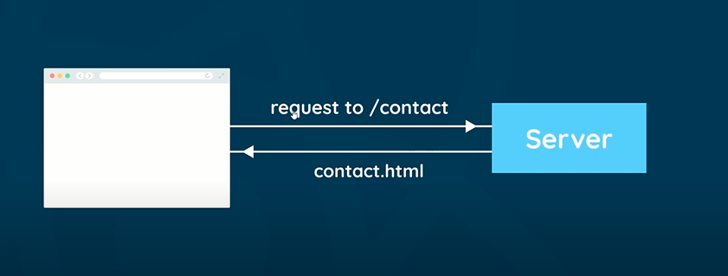
Normal Page Routing

